Slide 1
DEPARTMENT OF WAR • UNIVERSITY RESEARCH INITIATIVE
Fiscal Year 2027 Multidisciplinary University Research Initiative (MURI)
Faculty Information Session | Funding Opportunity Overview & Application Roadmap
Sponsoring Agencies: Office of Naval Research (ONR) | Army Research Office (ARO) | Air Force Office of Scientific Research (AFOSR)
Ramaraja Ramasamy, College of Engineering
October 5, 2026
FY27 Department of War MURI Announcement (ONR / ARO / AFOSR) | Slide 1 of 15

Slide 2
FY27 MURI FUNDING OPPORTUNITY
MURI Mission: Driving High-Risk, Multidisciplinary Basic Science Breakthroughs
Core Program Objectives
• High-Risk Basic Research: Addresses fundamental scientific phenomena that have never been achieved before (RDT&E Budget Activity 1).
• Cross-Disciplinary Synergy: Supports teams where multiple traditional S&E disciplines interact to yield rapid technological leaps.
• Defense Capabilities: Directly aligned with Department of War long-term national security priority areas (EO 14332 & OMB M-25-34).
• Active Service Management: Close interaction and research guidance from Service Program Officers throughout the grant term.
Human Capital & Scientific Impact
• Workforce Development: Educates graduate students and postdocs to cultivate a defense-aware, highly skilled STEM workforce.
• University Leadership: Complements single-investigator programs by enabling multi-faculty academic consortia.
• Substantial Legacy: Established in 1985 (40+ year record of foundational breakthroughs in quantum, materials, AI, and photonics).
• Unclassified Scope: Focuses strictly on unclassified, contracted fundamental research across degree-granting U.S. universities.
FY27 Department of War MURI Announcement (ONR / ARO / AFOSR) | Slide 2 of 15

Slide 3
FY27 MURI FUNDING OPPORTUNITY
Award Structure: Up to $1.5M/Year Over a 5-Year (3+2) Performance Period
~$170M
Total Program Budget
Estimated 5-year total availability across ONR, ARO, and AFOSR (pending appropriations).
$1.5M / Year
Typical Annual Ceiling
Average funding per award. AFOSR caps requests strictly at $15M max total.
3 Base + 2 Option
5-Year Total Duration
Awards executed as a 3-year base period ($4.5M) plus a 2-year option ($3.0M).
Sponsor Agency | Fiscal Year Increments | 3-Year Base Subtotal | 2-Year Option Subtotal
ONR (Navy) | Aug 1 - Oct 31 Cycle (3mo, 12mo, 12mo, 9mo) | $4,500,000 | $3,000,000 (Total: $7.5M)
ARO (Army) | Aug 1 - Sep 30 Cycle (2mo, 12mo, 12mo, 10mo) | $4,500,000 | $3,000,000 (Total: $7.5M)
AFOSR (Air Force) | Aug 1 - Oct 31 Cycle (3mo, 12mo, 12mo, 9mo) | $4,500,000 | $3,000,000 (Total: $7.5M)
FY27 Department of War MURI Announcement (ONR / ARO / AFOSR) | Slide 3 of 15

Slide 4
FY27 MURI FUNDING OPPORTUNITY
Past History of MURI Awards
FY2023
31 Awards
$220 Million
61 Universities
FY2024
28 Awards
$200 Million
59 Universities
FY2025
26 Awards
$200 Million
67 Universities
FY2025
382 White Papers
95 Full Proposals
26 Awards
~ $7.5M per award
Many institutions have received multiple MURI awards in the same year including two as Lead Institutions
List of Fy23 awards: https://media.defense.gov/2023/Mar/21/2003183593/-1/-1/1/FISCAL-YEAR-2023-RESEARCH-FUNDING-AWARDS.PDF
List of Fy24 awards: https://media.defense.gov/2024/Mar/08/2003409172/-1/-1/1/FY24_MURI_FINAL.PDF
FY27 Department of War MURI Announcement (ONR / ARO / AFOSR) | Slide 3 of 15

Slide 5
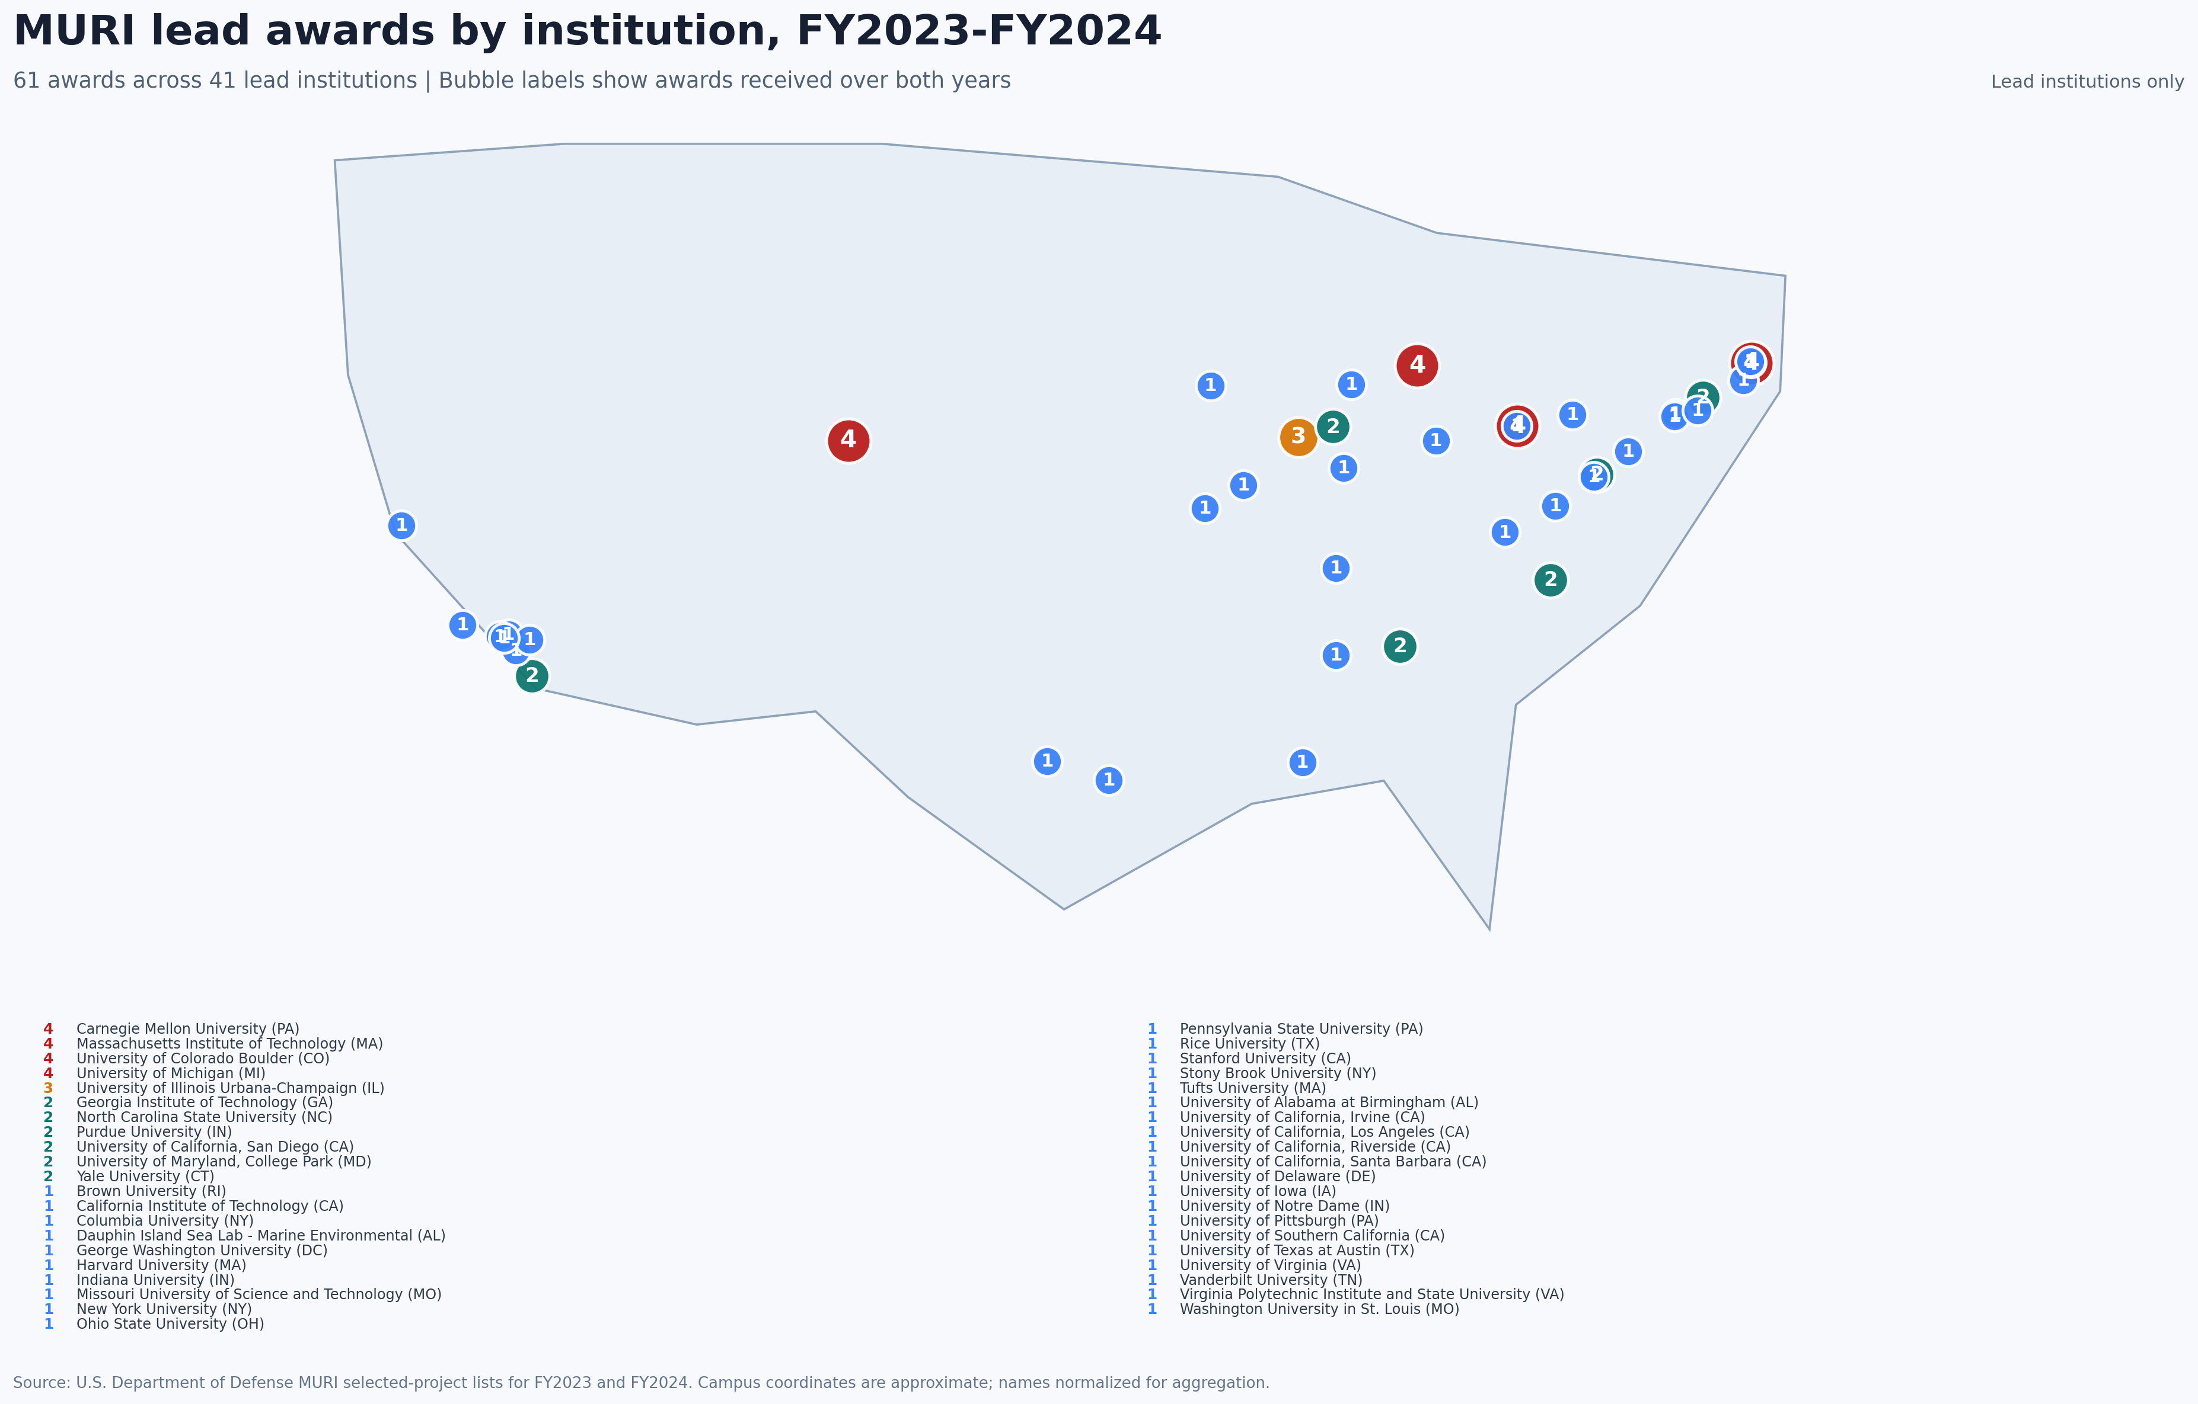
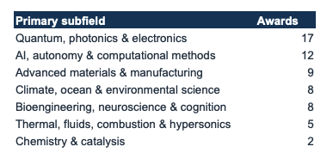
FY27 MURI FUNDING OPPORTUNITY
Past History of MURI Awards
FY27 Department of War MURI Announcement (ONR / ARO / AFOSR) | Slide 3 of 15

Slide 6
FY27 MURI FUNDING OPPORTUNITY
Timeline: Key Deadlines from White Papers to FY27 Award Start
STEP 1
Nov 6, 2026
Questions Due
Eligibility & technical inquiries cutoff.
STEP 2
Nov 20, 2026
White Papers Due
5:00 PM ET via agency portals (strongly recommended).
STEP 3
Jan 8, 2027
Evaluations Returned
Encourage / discourage feedback from Topic Chiefs.
STEP 4
Apr 9, 2027
Full Proposals Due
5:00 PM ET via Grants.gov Workspace.
STEP 5
Jul / Aug 2027
Selection & Award Start
Selections announced July; Grant start Aug 1, 2027.
FY27 Department of War MURI Announcement (ONR / ARO / AFOSR) | Slide 4 of 15

Slide 7
FY27 MURI FUNDING OPPORTUNITY
Eligibility: U.S. Universities Lead; Non-Academic Partners Role Restricted
Eligible Prime Proposers
✔ Degree-Granting U.S. Universities: Restricted exclusively to U.S. institutions of higher education with degree-granting S&E programs (including DoW institutions).
✔ Single Lead PI & Primary Institution: Proposals must designate one Principal Investigator from the primary submitting university.
✔ UARCs Eligible: University Affiliated Research Centers (UARCs) are eligible if part of a university and not designated as FFRDCs.
✔ No Application Limit: No restriction on the number of proposals an institution may submit under this NOFO.
Ineligible Organizations & Collaborators
✖ MURI Funding Prohibition: Industry, DoW labs, FFRDCs, and foreign entities CANNOT receive MURI funds directly or via subaward.
✖ Non-Funded Collaborators: Ineligible organizations may collaborate as non-funded team members.
✖ Separately Funded Proposals: When required, collaborators may submit a separate supplemental proposal attached to the primary MURI proposal (funded via non-MURI funds if approved).
✖ Multi-Proposal PIs: PIs proposing on multiple topics/proposals must get prior approval from Topic Chiefs before white paper submission.
FY27 Department of War MURI Announcement (ONR / ARO / AFOSR) | Slide 5 of 15

Slide 8
FY27 MURI FUNDING OPPORTUNITY
16 Multidisciplinary Topics Across AFOSR, ARO, and ONR
AFOSR (Air Force)
Topics 1 - 5 (5 Topics)
• Optically Thick Non-linear Mixing
• Tunable Goniopolar Semiconductors
• AI Robustness for Scientific Discovery
• TEM Ptychography Advances
• Optical Cycling Centers (SOCCER)
ARO (Army)
Topics 6 - 11 (6 Topics)
• Solid-State Thorium-229 (TESS)
• Reticular Qubit Assemblies
• Superomniphobic Bio-Assay Design
• Fire/Smoke Particulate Biogeochemistry
• Multiphase Superconcentration
• Atomic/Molecular Hybrid Quantum Solids
ONR (Navy)
Topics 12 - 16 (5 Topics)
• AI vs Human Content Authentication
• Troposcatter Atmospheric Sensitivity
• Interface Biofilm Function Control
• High-Entropy Electrochemical Materials
• Bio-Inspired Recurrent Self-Healing
FY27 Department of War MURI Announcement (ONR / ARO / AFOSR) | Slide 6 of 15

Slide 9
FY27 MURI FUNDING OPPORTUNITY
AFOSR Focus: Quantum Optics, AI Reasoning, and Advanced Microscopy (Topics 1-5)
Topic # | Topic Title | Core Scientific Objectives & Key Requirements
Topic 1 | Non-linear Mixing in Optically Thick Systems | Explore wave-mixing cross-sections and core-level photon interactions (100eV-10keV) for advanced spectroscopy.
Topic 2 | Tunable Goniopolar Semiconductors | Elucidate directional charge transport (simultaneous p-x-n conductivity) influenced by external electric/magnetic fields.
Topic 3 | AI Robustness to Novel Scientific Queries | Build mathematical frameworks bridging learning and symbolic reasoning for out-of-distribution scientific queries.
Topic 4 | Unlocking Potential of TEM Ptychography | Overcome electron dose, speed, and computational bottlenecks for 3D atomic imaging of beam-sensitive matter.
Topic 5 | Science with Optical Cycling Centers (SOCCER) | Laser cooling of metal-molecule complexes for quantum-level energy redistribution, QIS, and precision timing.
FY27 Department of War MURI Announcement (ONR / ARO / AFOSR) | Slide 7 of 15

Slide 10
FY27 MURI FUNDING OPPORTUNITY
ARO Focus: Nuclear Clocks, Quantum Reticular Chemistry, & Extreme Regimes (Topics 6-11)
Topic # | Topic Title | Core Scientific Objectives & Key Requirements
Topic 6 | Thorium-229 Enabled Solid State (TESS) | Investigate laser-accessible nuclear transitions in solid-state hosts for nuclear clocks and ultra-stable QIS.
Topic 7 | Reticular Qubit Assemblies | Deterministic synthesis of ordered molecular spin qubits using reticular frameworks with spin-optical interfaces.
Topic 8 | Superomniphobic Materials via Biological Assays | Create non-toxic, durable super-repellent surfaces coupling multi-scale materials science and high-throughput bioassays.
Topic 9 | Biogeochemical Matrix of Smoke Particulates | Decode microbial protection and survival in pyrolyzed particulates across fire and atmospheric transport regimes.
Topic 10 | Interfacial Superconcentration Regimes | Understand ion dynamics, coordination, and microbial response at extreme superconcentrated multiphase interfaces.
Topic 11 | Atomic & Molecular Hybrid Quantum Solids | Synthesize self-assembled intercalated 2D vdW superlattices to control charge, exciton, and spin interactions.
FY27 Department of War MURI Announcement (ONR / ARO / AFOSR) | Slide 8 of 15

Slide 11
FY27 MURI FUNDING OPPORTUNITY
ONR Focus: AI Auth, Troposcatter, Biofilms, & High-Entropy Materials (Topics 12-16)
Topic # | Topic Title | Core Scientific Objectives & Key Requirements
Topic 12 | Distinguishing AI vs Human Content | Develop open-source model watermarking, LLM paragraph watermarking, and theory for content authentication.
Topic 13 | Troposcatter Atmospheric & EM Sensitivity | Elucidate environmental and atmospheric controls modulating beyond-line-of-sight microwave radio links.
Topic 14 | Interface Mediated Control of Biofilm Function | Design engineered materials acting as 'ecological conductors' to recruit native biofilms for corrosion/fouling control.
Topic 15 | High-Entropy Electrochemical Materials | Deconvolve atomic multi-element 'cocktail effects' in HEMs for superionic conductivity and energy storage.
Topic 16 | Bio-Inspired Recurrent Self-Healing Materials | Exploit 3D/4D printing and vascular networks for autonomous, multi-cycle damage repair in synthetic structures.
FY27 Department of War MURI Announcement (ONR / ARO / AFOSR) | Slide 9 of 15

Slide 12
FY27 MURI FUNDING OPPORTUNITY
White Papers: Max 4 Pages; Essential First Step for Early Topic Chief Feedback
White Paper Format & Structure
• Strict Page Limit: Max 4 single-sided pages (excluding cover page, cover letter, references, and CVs). Pages beyond 4 will not be read.
• Formatting Rules: 8.5x11-inch, 1-inch margins, single-spaced, Times New Roman 12-pt font.
• Key Content: Scientific hypothesis/approach, DoW capability impact, proposed team/management plan, cost summary, key investigator CVs.
• Multi-Topic PIs: Must declare PI availability and obtain Topic Chief pre-approval if proposing on multiple topics.
Agency Submission Portals (Nov 20, 2026)
• AFOSR (Topics 1-5): Submitted online via Qualtrics portal (https://afosr.gov1.qualtrics.com/). Contact: afosr.rtb.muri@us.af.mil
• ARO (Topics 6-11): Submitted via Email directly to the Topic Chief (or USPS/commercial carrier). Contact: devcom-arl.mbx.aro-muri@army.mil
• ONR (Topics 12-16): Submitted via ONR Submission Portal (https://submissions.nre.navy.mil/). Also CC Topic Chief & Dr. Amanda Netburn.
• Evaluation Feedback: Informal feedback returned by Jan 8, 2027 encouraging or discouraging full proposal submission (or suggesting re-teaming).
FY27 Department of War MURI Announcement (ONR / ARO / AFOSR) | Slide 10 of 15

Slide 13
FY27 MURI FUNDING OPPORTUNITY
Full Proposal: 25-Page Limit on Technical Narrative; Submitted via Grants.gov
INCLUDED in 25-Page Technical Limit
• Technical Approach: Scientific concept, hypothesis-driven research plan, innovation, literature comparison, and breakthroughs.
• Future DoW Relevance: Specific mission contributions and long-term national security impact.
• Schedule & Milestones: Summary schedule of research events and measurable benchmarks.
• Management Approach: PI/Co-PI communication, data sharing, student training plan (FTE counts).
• PI Qualifications: Qualifications of key personnel and team roles.
EXCLUDED from 25-Page Page Limit
• SF-424 & Cover Page / TOC: Mandatory forms, cover letter, and table of contents.
• Detailed Budget & Justification: R&R Budget form, subaward budgets, and single-audit link.
• Data Management Plan (DMP): Max 2 pages describing data sharing, preservation, and formats.
• Senior/Key Person Profiles: NSF Biosketches and Current & Pending Support forms.
• Facilities, Equipment, & References: Descriptions of resources and literature bibliography.
FY27 Department of War MURI Announcement (ONR / ARO / AFOSR) | Slide 11 of 15

Slide 14
FY27 MURI FUNDING OPPORTUNITY
Evaluation Criteria: Technical Merit, Fundamental Breakthroughs, & DoW Relevance
1. Scientific & Technical Merit — Rigour and innovation of proposed basic science/engineering research.
2. Advancement of Fundamental Knowledge — Potential to significantly advance fundamental understanding in topic area.
3. DoW Relevance & Mission Impact — Potential relevance and contribution to Department of War mission priorities.
4. PI & Key Personnel Qualifications — Qualifications, track record, and time availability of PI and co-investigators.
5. Facilities, Equipment, & DMP Strength — Adequacy of research facilities and rigor of the Data Management Plan.
6. Organizational Synergies — Impact of interactions with DoW labs, industry, and defense R&D organizations.
7. Cost Realism & Reasonableness — Realism of proposed budget (note: cost-sharing is not evaluated).
FY27 Department of War MURI Announcement (ONR / ARO / AFOSR) | Slide 12 of 15

Slide 15
FY27 MURI FUNDING OPPORTUNITY
Gold Standard Science (GSS): EO 14303 & EO 14332 Mandate 9 Scientific Tenets
1. Reproducible
Research methods & results must be independently verifiable.
2. Transparent
Full open disclosure of data, workflows, and analytical tools.
3. Error Communication
Explicit quantification and reporting of error and uncertainty.
4. Collaborative
Active interdisciplinary team science and cross-institutional synergy.
5. Skeptical Approach
Rigorously skeptical of assumptions, findings, and models.
6. Falsifiable Hypotheses
Research structured explicitly for testing and potential falsification.
7. Unbiased Peer Review
Subject to rigorous, conflict-free, objective peer review.
8. Accepting Negative Results
Negative experimental outcomes recognized as valuable scientific data.
9. Zero Conflict of Interest
Strict elimination and disclosure of financial/personal conflicts.
Certification Requirement: Checking 'I Agree' on SF-424 Block 17 certifies institutional commitment to GSS tenets and clear progress benchmarks (EO 14332).
FY27 Department of War MURI Announcement (ONR / ARO / AFOSR) | Slide 13 of 15

Slide 16
FY27 MURI FUNDING OPPORTUNITY
Research Security: Risk-Based Reviews (NSPM-33) & Mandatory Disclosures
Mandatory Disclosures & Reviews
• NSPM-33 Risk Reviews: All proposed 'Covered Individuals' undergo risk-based security evaluation against DoW decision matrices.
• Current & Pending Support: Complete disclosure of all foreign/domestic research support required on common forms; updated annually.
• ORCID Digital Identifiers: Mandatory digital persistent identifier (ORCID ID) for all key personnel (SciENcv or SF-424 field).
• 5-Day Foreign Change Notice: Must report any foreign talent affiliations or funding changes within 5 business days during award performance.
Statutory Funding Prohibitions
🚫 Malign Foreign Talent Programs: Actively participating in malign foreign talent recruitment programs results in mandatory denial/prohibition (CHIPS Act 2022).
🚫 Confucius Institutes Prohibition: Institutions hosting a Confucius Institute are legally prohibited from receiving DoW funding (NDAA 2021).
🚫 Covered Telecommunications: Prohibition under NDAA Section 889 on covered telecom/video equipment (e.g., Huawei, ZTE, Hikvision).
🚫 False Claims Act Liability: Material misstatements or omissions in foreign support disclosures subject personnel to criminal/civil penalties.
FY27 Department of War MURI Announcement (ONR / ARO / AFOSR) | Slide 14 of 15

Slide 17
FY27 MURI FUNDING OPPORTUNITY
Action Plan for Faculty: Immediate Steps to Prepare Competitive MURI Proposals
1. Early Topic Chief Contact
Initiate technical conversations with Research Topic Chiefs before Nov 6 to discuss project alignment and multi-topic PI participation.
2. Assemble Multi-Disciplinary Team
Form high-impact consortia across degree-granting universities to address all facets of the chosen research topic.
3. Submit White Paper by Nov 20
Draft concise 4-page white paper focused on high-risk technical vision, DoW impact, and benchmarked milestones.
4. Prepare Registrations & Security
Ensure SAM.gov registration is active, UEI/CAGE codes ready, and all key personnel have active ORCID IDs.
FY27 Department of War MURI Announcement (ONR / ARO / AFOSR) | Slide 15 of 15

Slide 18
FY27 MURI FUNDING OPPORTUNITY
The MURI Mandate:
High-Risk Science
Farsighted, high-payoff basic research directed toward fundamental knowledge, rather than immediate product development.
Multidisciplinary Teams
World-class faculty, postdocs, and graduate students work across traditional disciplines to tackle complex problems.
One primary U.S. institution awardee
U.S. University PI
DoW Relevance
Research addresses future challenges faced by the Department of War, guided by active Service Program Officers.
FY27 Department of War MURI Announcement (ONR / ARO / AFOSR) | Slide 17 of 19

Slide 19
FY27 MURI FUNDING OPPORTUNITY
The FY27 Path to Award
Nov 6, 2026
White Paper Q&A Deadline
Nov 20, 2026
White Papers Due
5:00 PM EST
Jan 8, 2027
Initial White Paper Feedback Notifications
Mar 12, 2027
Application Q&A Deadline
Apr 9, 2027
Full Proposals Due
via Grants.gov
July 2027
Selection Notifications
August 2027
Anticipated Grant Start Date
Submit 24–48 hours early to Grants.gov to allow time to resolve system validation errors.
The Grants.gov timestamp is proof of timely submission.
FY27 Department of War MURI Announcement (ONR / ARO / AFOSR) | Slide 18 of 19

Slide 20
FY27 MURI FUNDING OPPORTUNITY
Communications & Routing Directory
Technical Questions
Direct to:
Specific Topic Chiefs listed in Section I of the NOFO.
Routing rule
Inquiries must reference specific Topic Numbers.
Policy & Program Questions
ONR: Dr. Amanda Netburn
Amanda.N.Netburn.civ@us.navy.mil
ARO: Dr. Sue Kase
usarmy.rtp.devcom-arl.mbx.aro-muri@army.mil
AFOSR: Ms. Katie Wisecarver
afosr.rtb.muri@us.af.mil
Grants.gov / Contracting Questions
ONR: Veronica Lacey
ARO: Ramila Century
AFOSR: Jorge Gallegos
Always include the NOFO number in the subject line of all correspondence.
Questions submitted within 2 weeks of a deadline may not receive a response.
FY27 Department of War MURI Announcement (ONR / ARO / AFOSR) | Slide 19 of 19

